Slide 1


BirdGO
Bryan Ong, Chua Yong Xuan, Lim Xin Yi, Jared Tan, Tan Jia Min, Timothy Teh

Slide 2
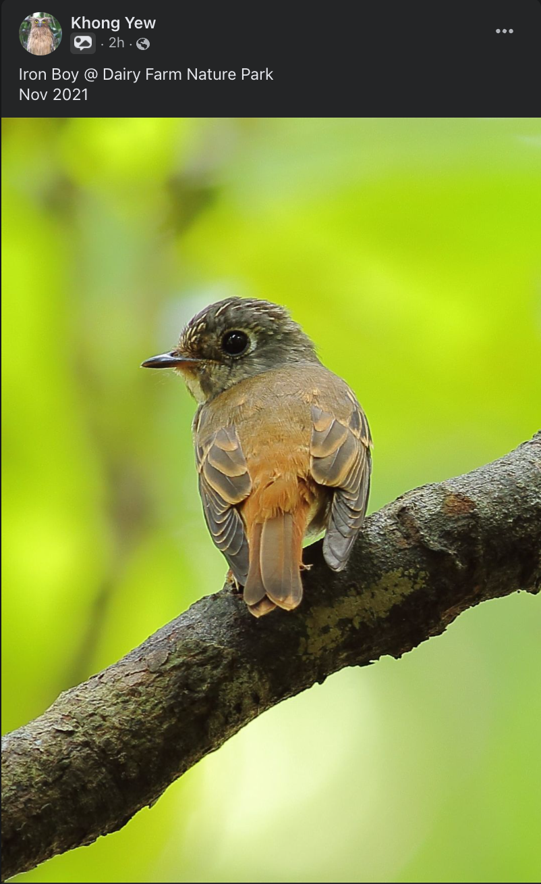
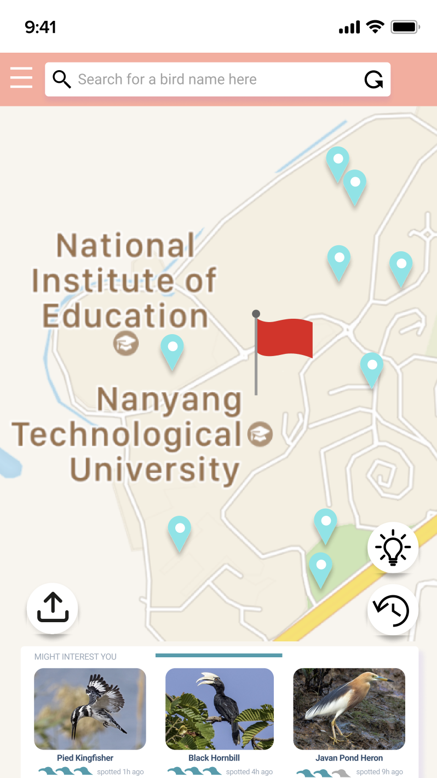
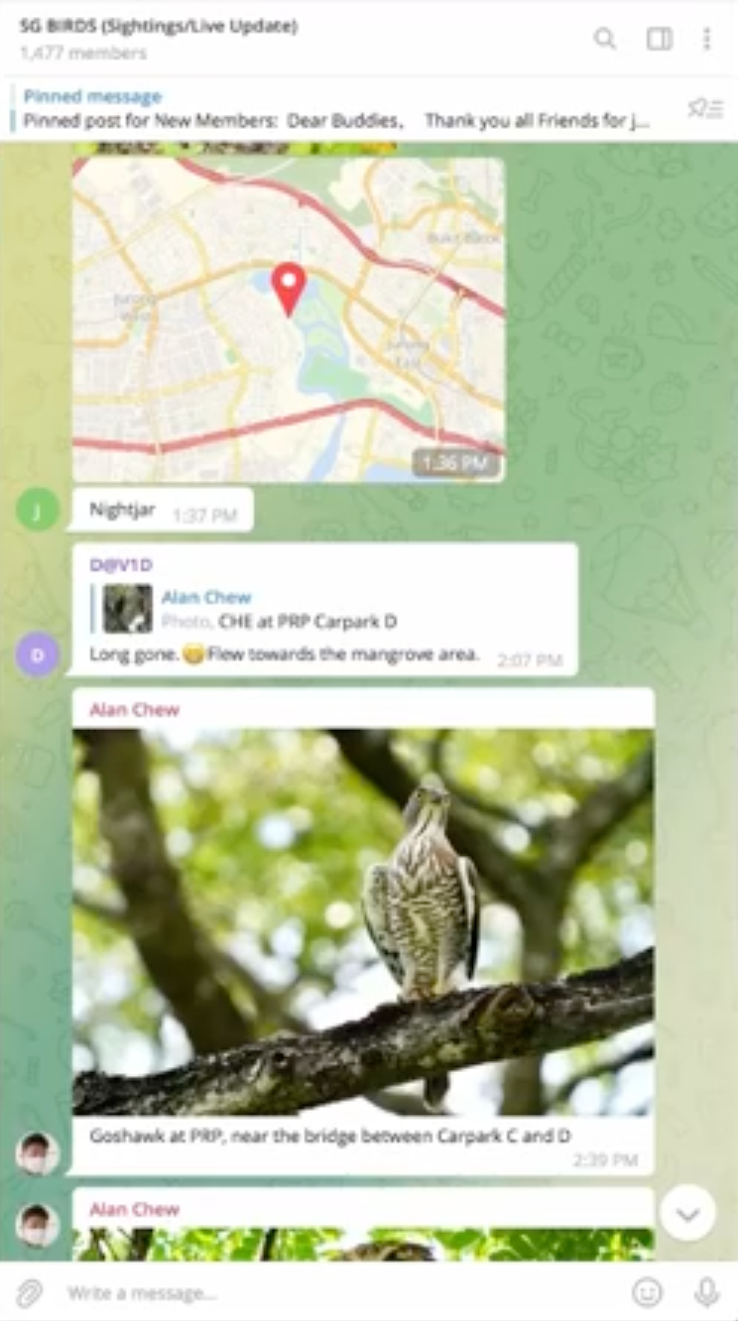
The Problem
Facebook
Telegram

Slide 3
Our Idea
Find birds through crowdsourcing
View all sightings on a map
Share bird sightings with other users
Find bird using predictions
Learn more about each bird

Slide 4
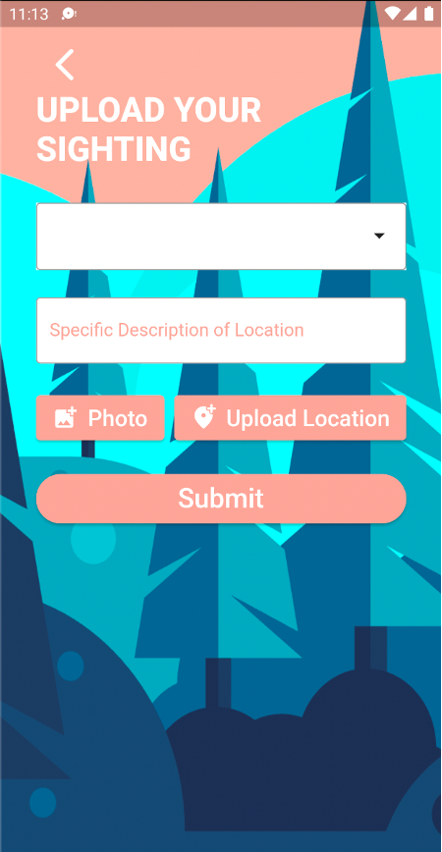
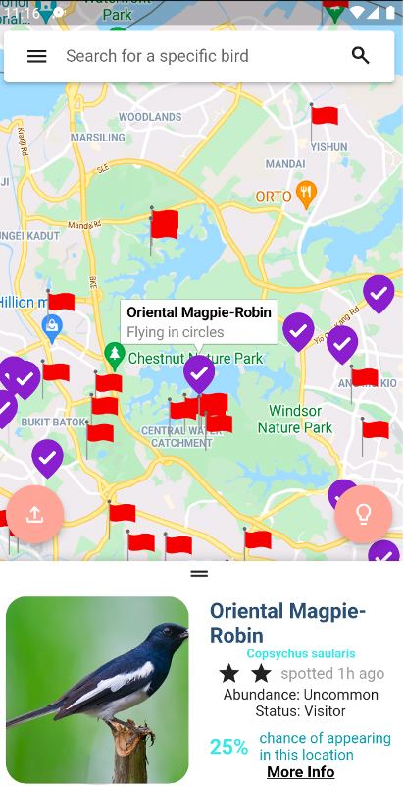
Functional Requirements
Upload Page
Interactive Map

Slide 5
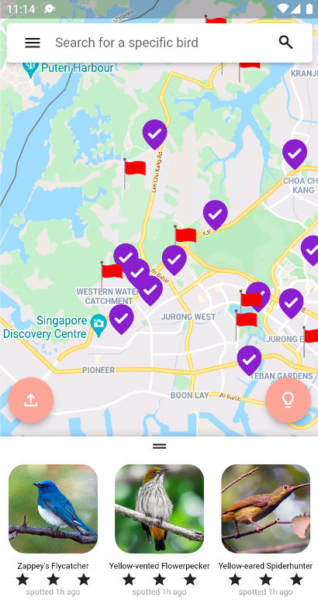
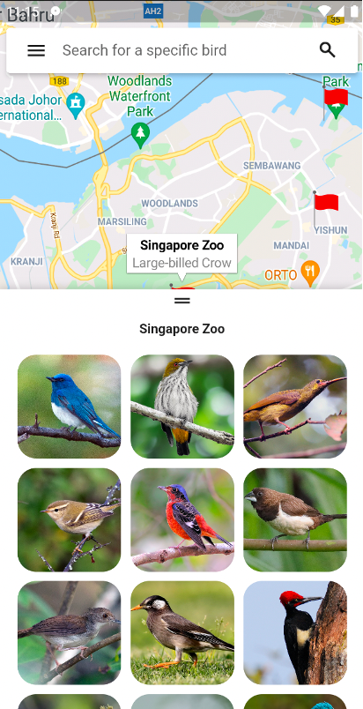
Functional Requirements
Top Three Birds
All Birds

Slide 6
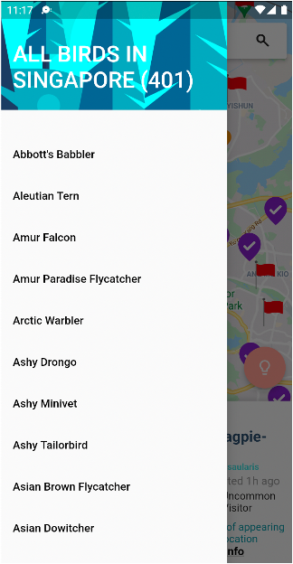
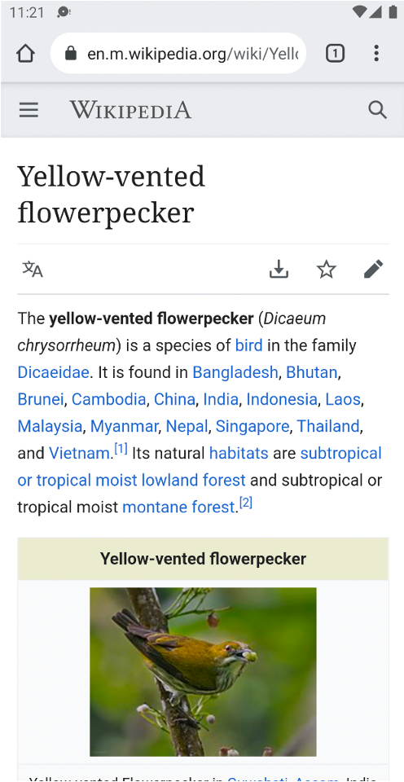
Functional Requirements
BirdGo Encyclopedia
Redirect to Wikipedia
Notes:
Why and what does it benefit

Slide 7


Tech Stack
Front-end: Flutter
Back-end: Firebase, Python

Slide 8
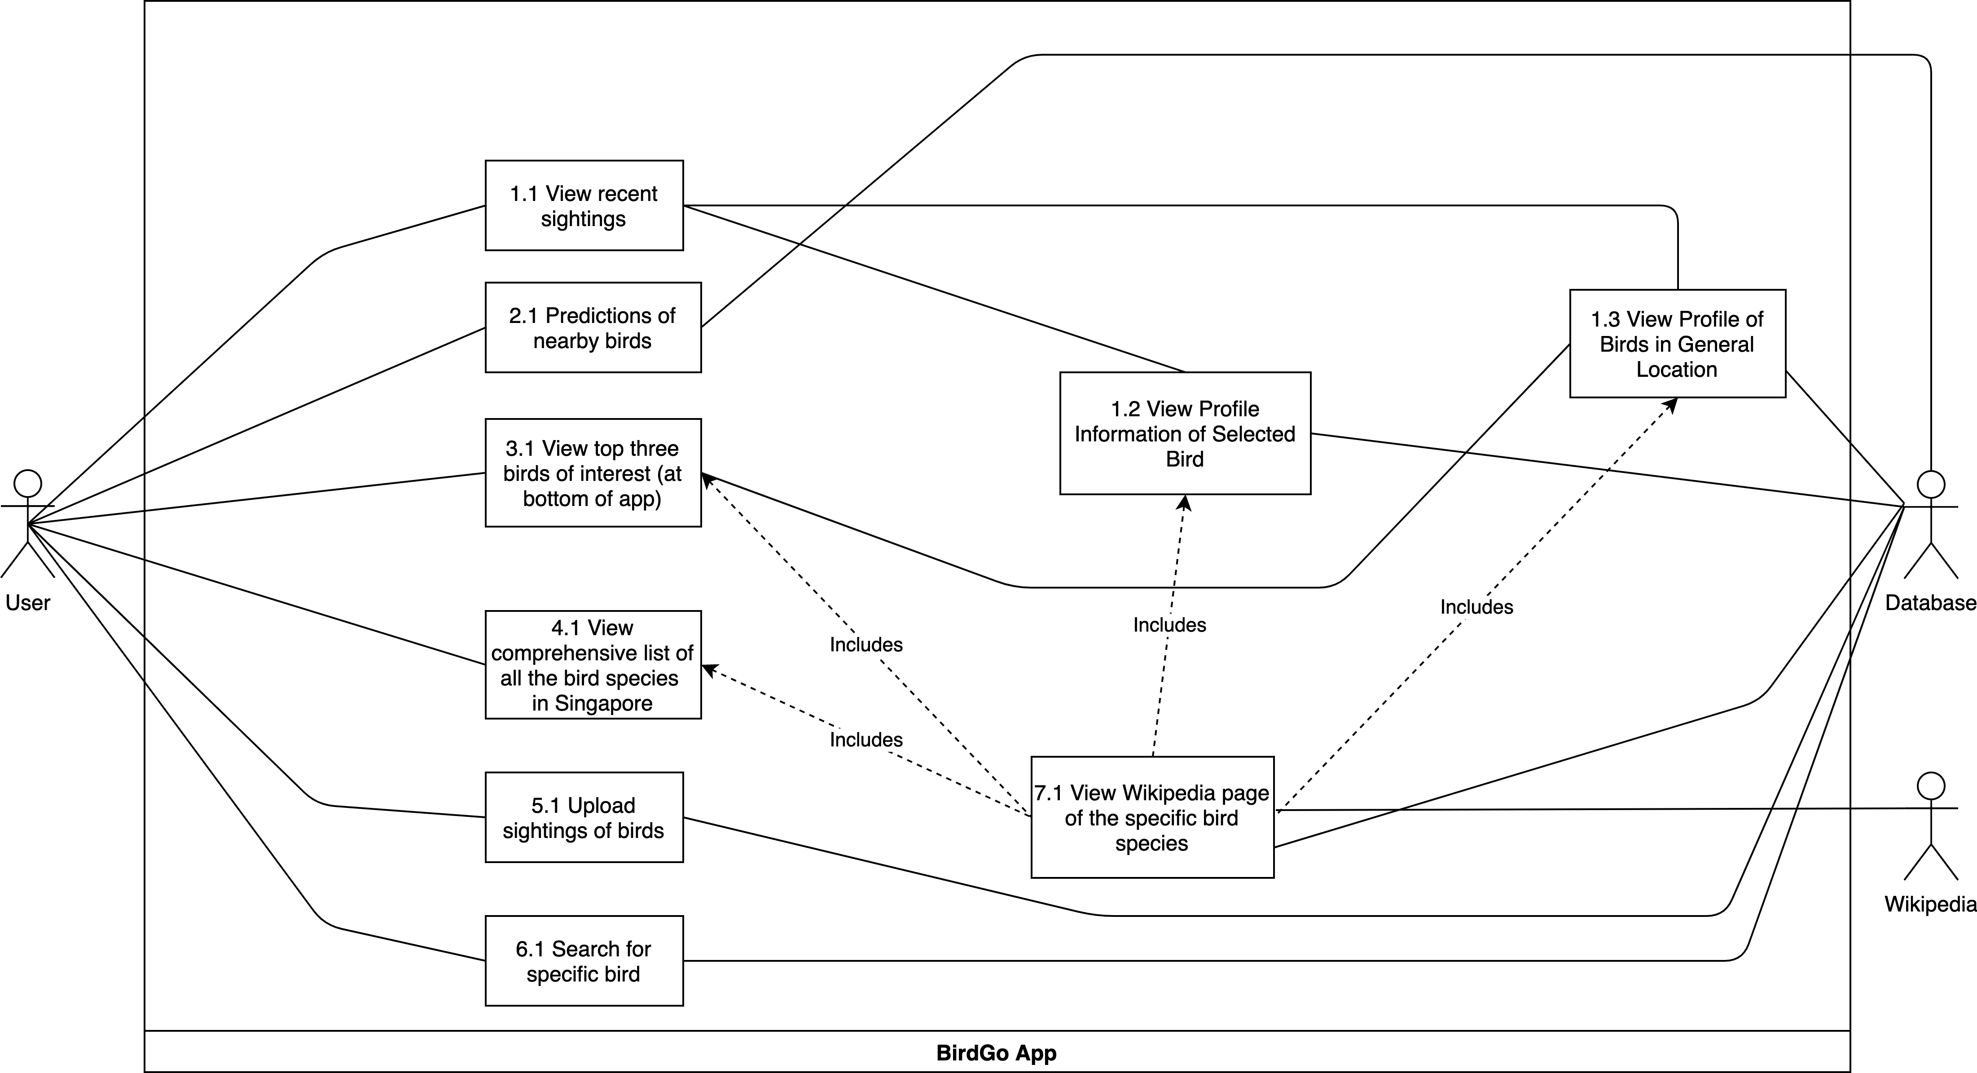
Use Case Diagram
Notes:
After figuring out the functional requirements for BirdGo, we came up with the use cases for the application. We identified 7 main use cases, as shown in the slide, and the actors interacting with the application system itself. The actors include the User, the Database and Wikipedia.

Slide 9
Initial Dialog Diagram
Notes:
Here is our initial dialog map, which shows the various user interfaces and the flow of usage. The user is greeted by the MapPageUI upon opening the application, and through the decision point can choose to navigate to various other screens, such as the SearchUI, UploadUI, or the ListOfBirdsUI.

Slide 10
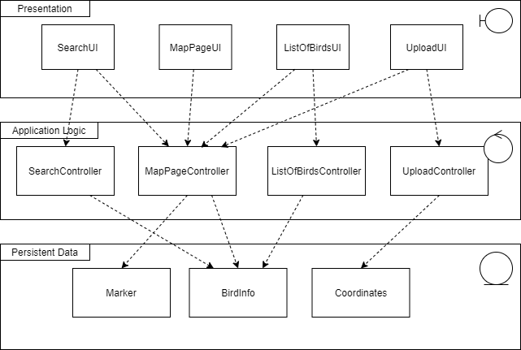
Model-View-Controller (MVC) Architecture
Splitting our class design into three distinct types:
Model: Classes which store data
View: Classes which handle UI
Controller: Classes which execute application logic
Notes:
In terms of good software engineering principles, we have adopted the model-view-controller architecture in our design of the application. Our class design is split into three different types, so that each class has their own area of responsibility instead of lumping the functionalities together. For instance, the SearchUI is in charge of displaying the search bar, but the logic is controlled by the SearchController, which calls upon the BirdInfo class to retrieve the searched data.

Slide 11
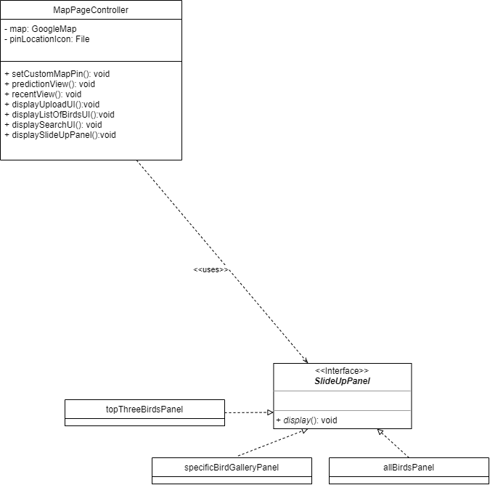
Strategy Design Pattern
- Make use of the open-closed principle in object design
- Program to an interface, not an implementation
- Opens program up for extension easily
Notes:
We have also adopted design patterns learnt from this course in our application. One of them is the strategy design pattern. We make use of the open-closed principle in object design for the SlideUpPanel class, which is an interface used by MapPageController. This way, we can easily add in new panels in the future if we need to, since we can just add new implementations to the SlideUpPanel interface.

Slide 12
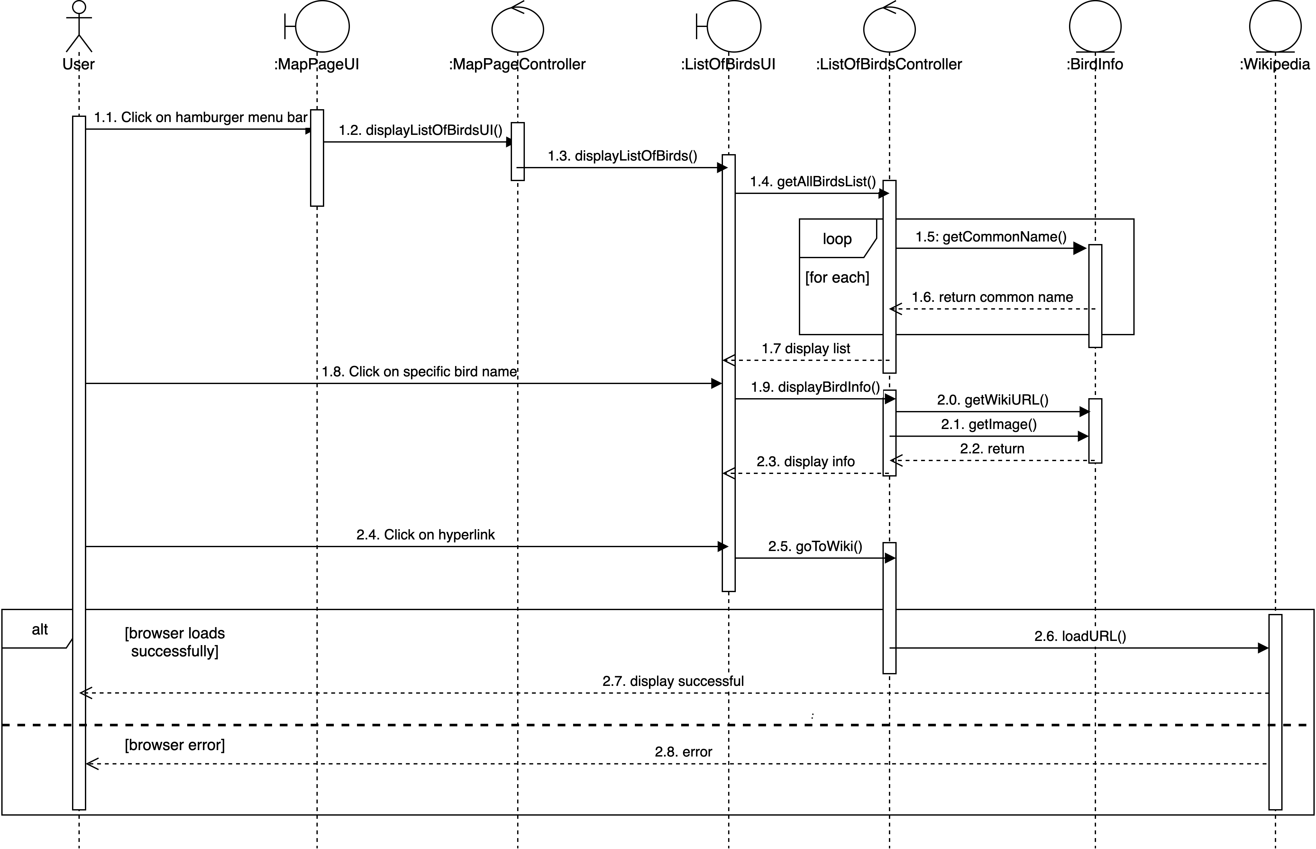
VIEW LIST OF ALL RARE BIRDS

Slide 13
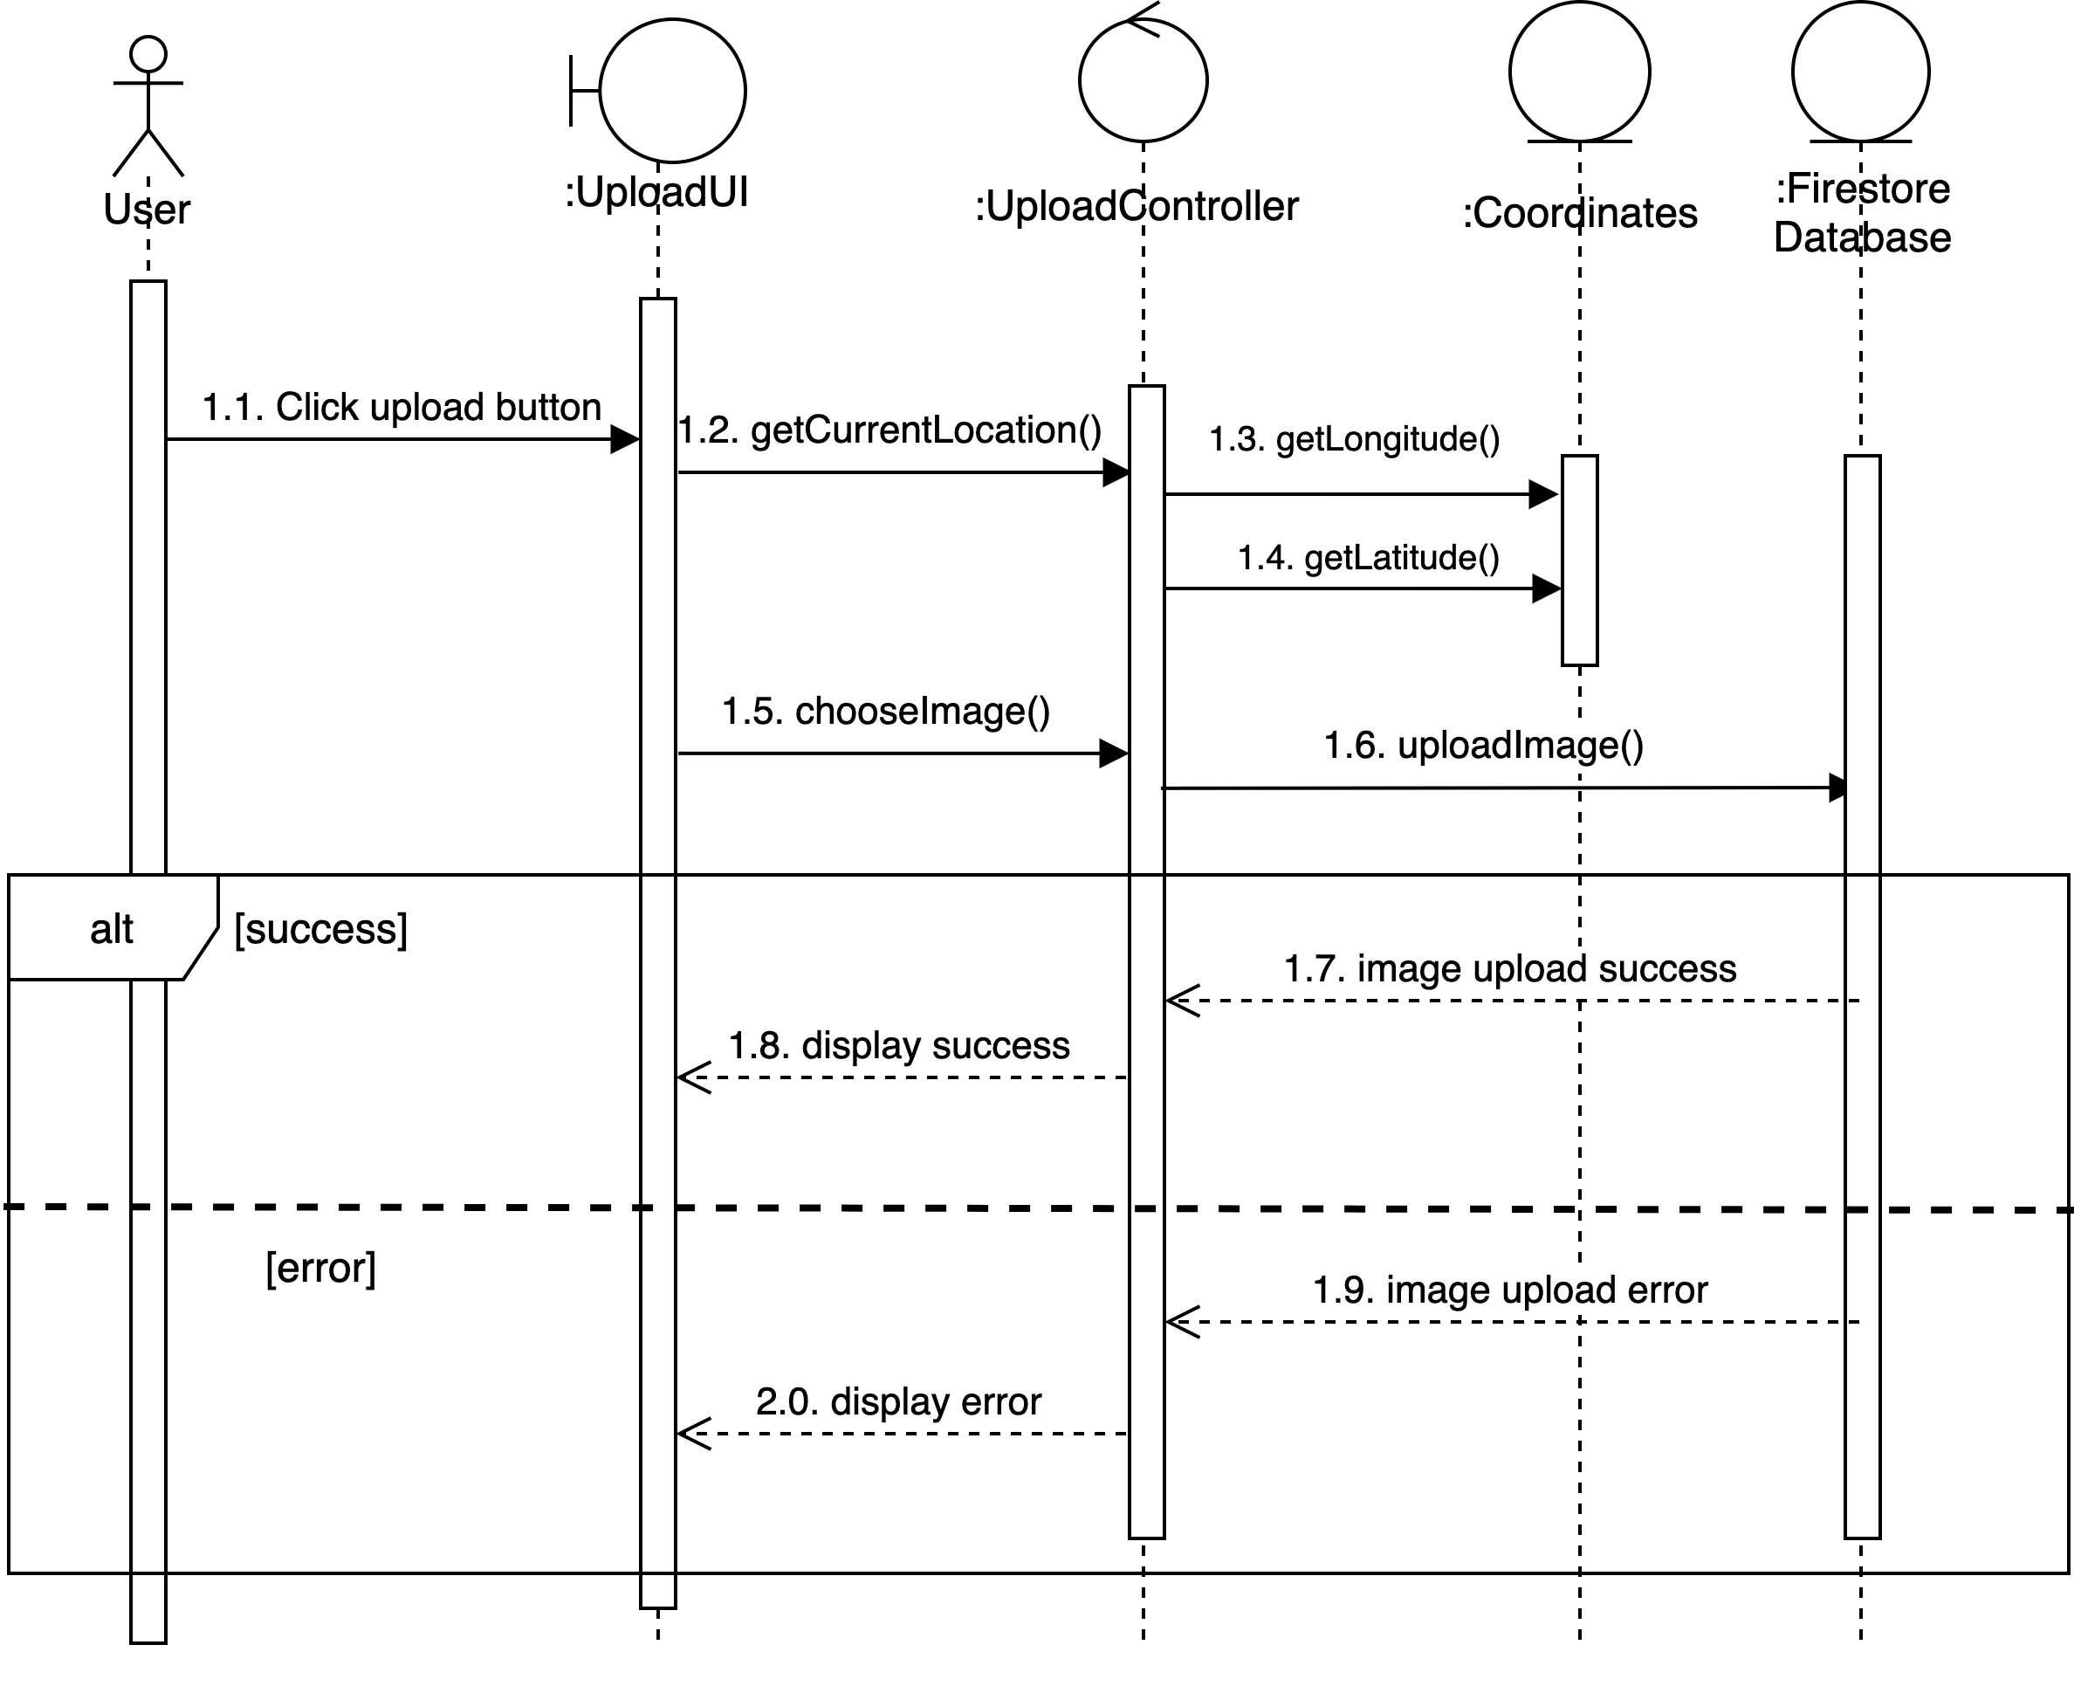
UPLOAD BIRD SIGHTING

Slide 14
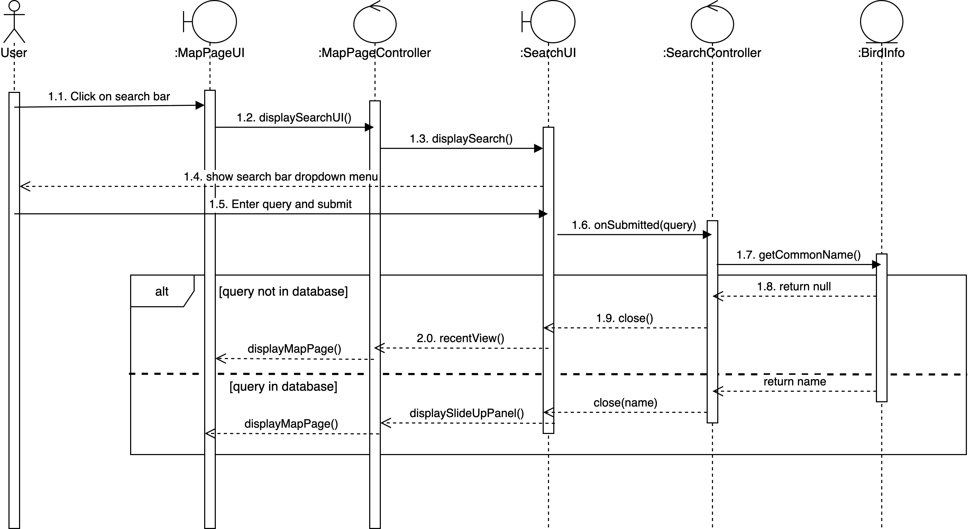
SEARCH FOR SPECIFIC BIRD

Slide 15
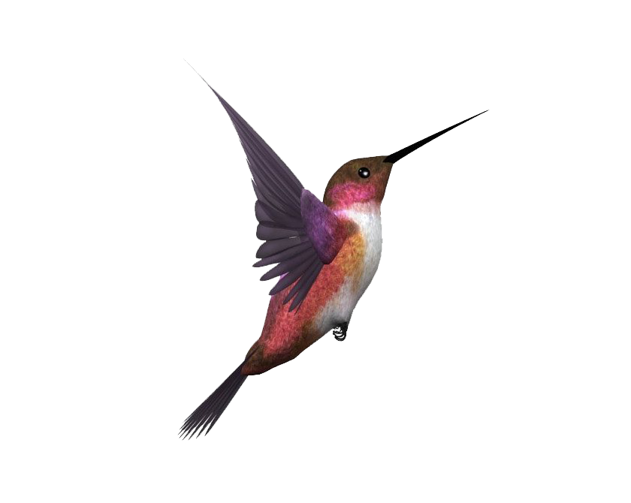
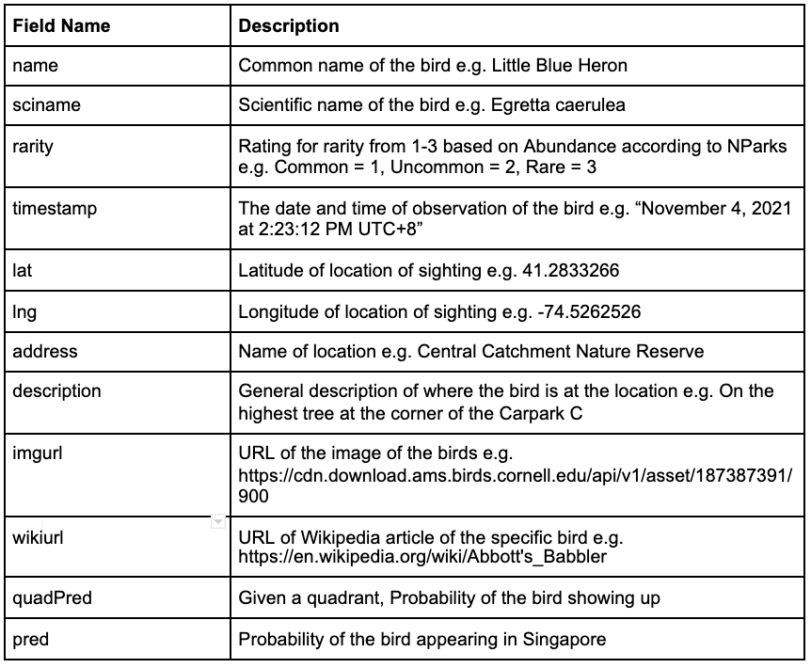
Data
Dictionary

Slide 16
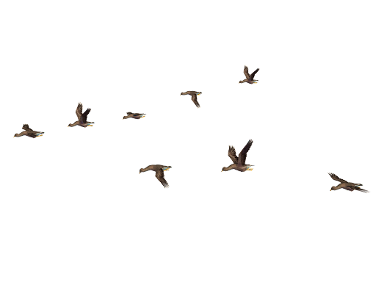


Data Base

Slide 17
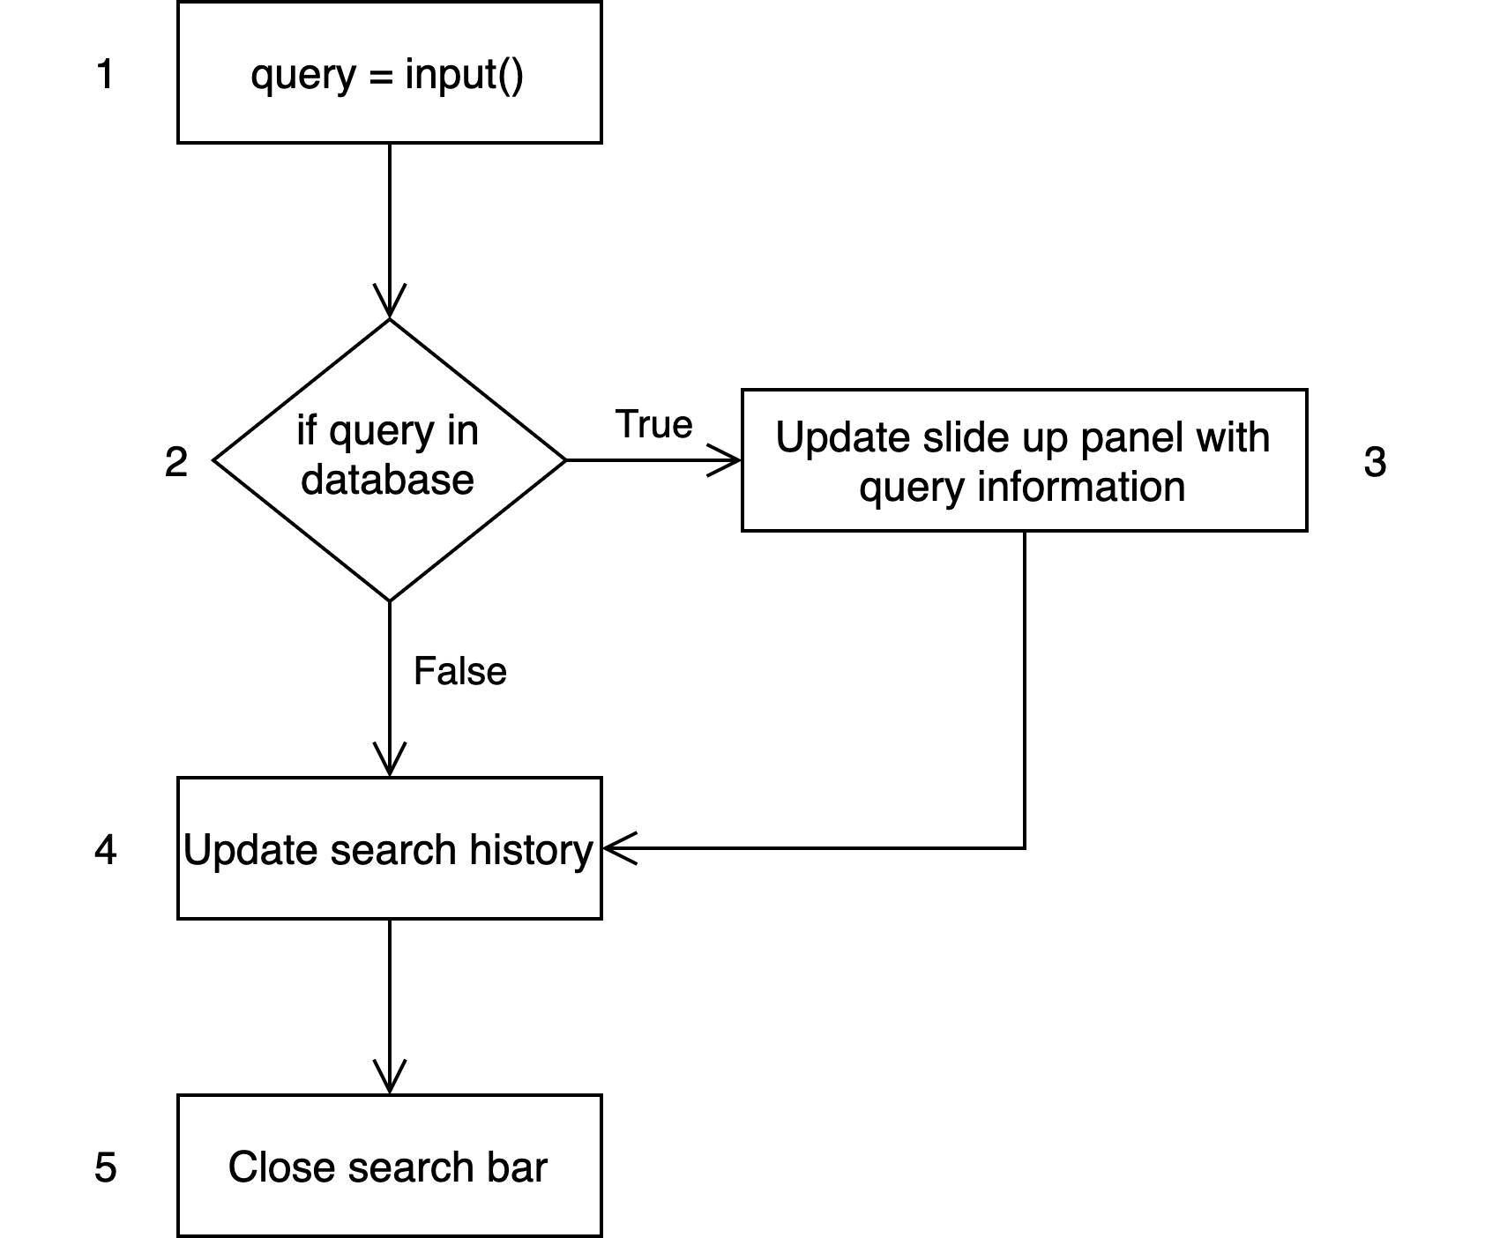
White Box Testing (Search Function)
Successful Search: 1,2,3,4,5
Unsuccessful Search: 1,2,4,5
“Pied Kingfisher”
“eongoegdfc”
“1234”
“Javan Mynah”

Slide 18
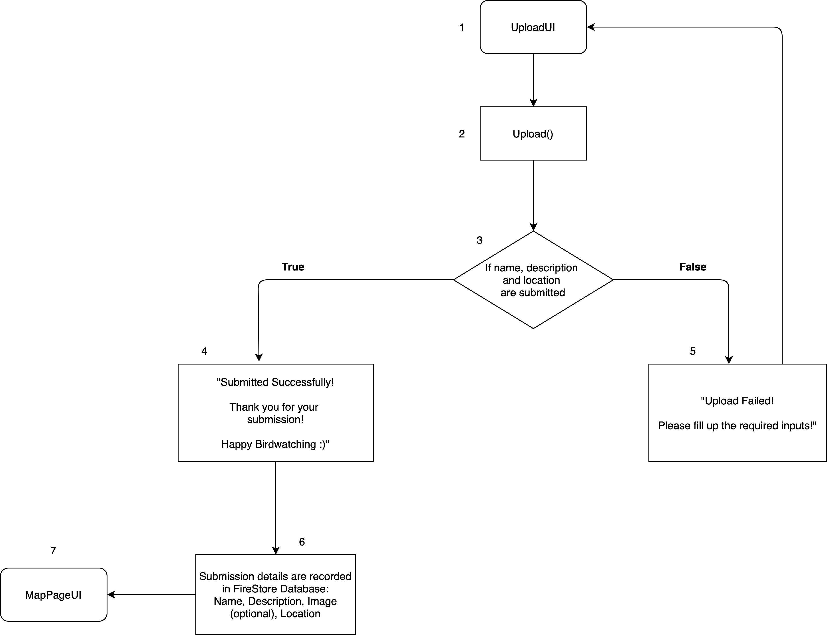
White Box Testing (Upload Function)
Successful Upload: 1,2,3,4,5,6,7
Unsuccessful Upload: 1,2,3,5
Name of Bird, Description, Location
Name of Bird, Description or Location not selected

Slide 19
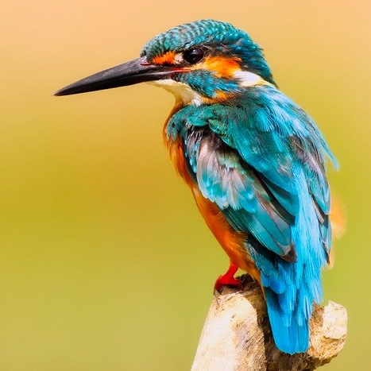
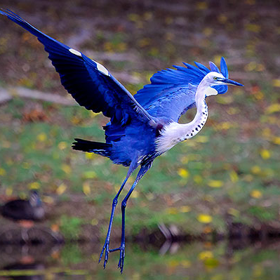
APP DEMO

Slide 20
QnA

Slide 21
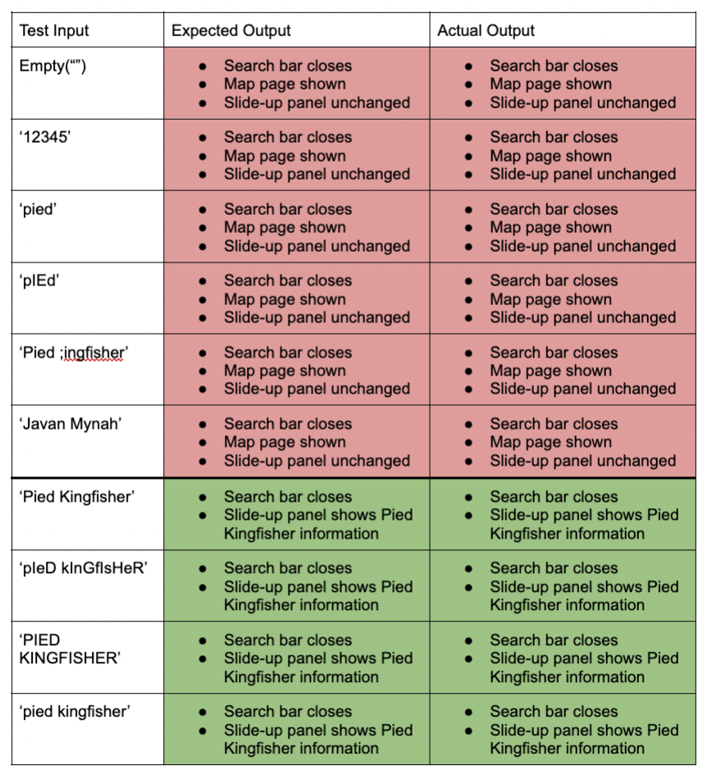
Black Box Testing (Search)
< invalid inputs
(empty, numbers, invalid bird names, names of non-rare birds)
< valid inputs
(upper & lowercase,
valid name of rare bird)

Slide 22
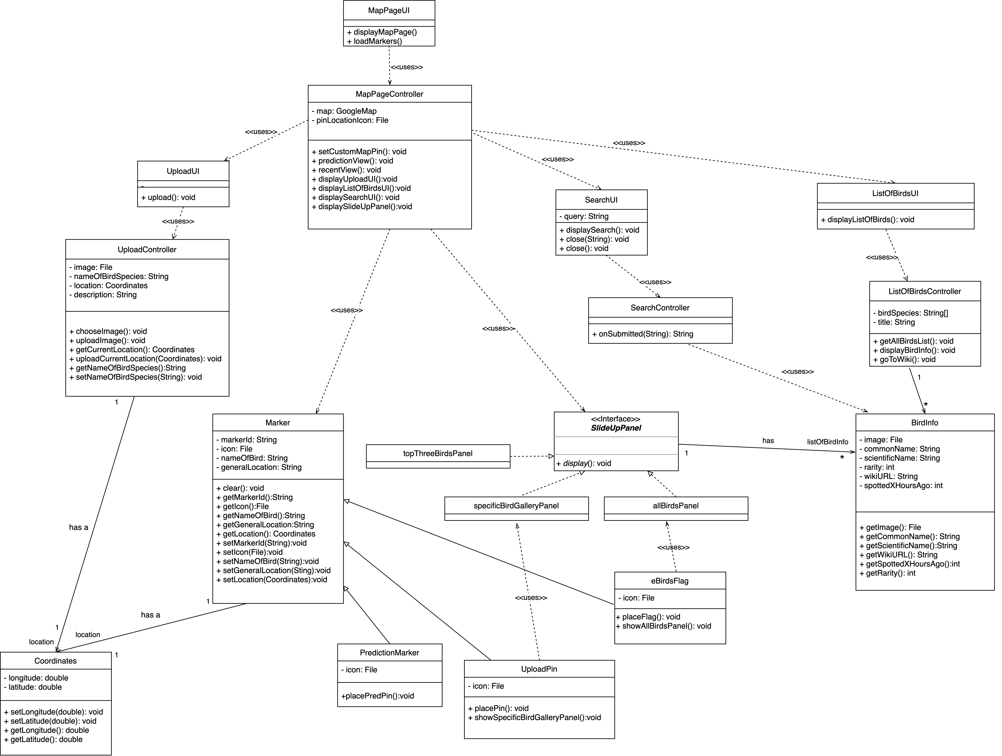
Class Diagram

Slide 23
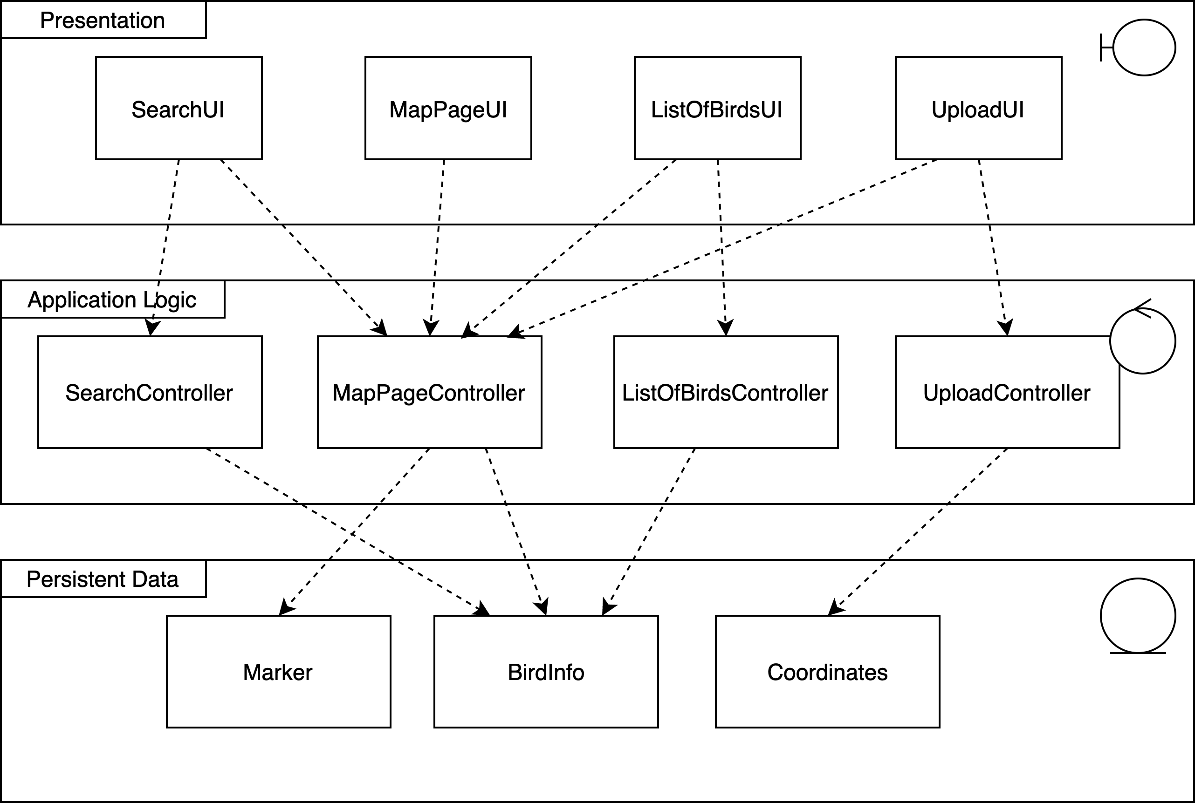
Layer Architecture

Slide 24
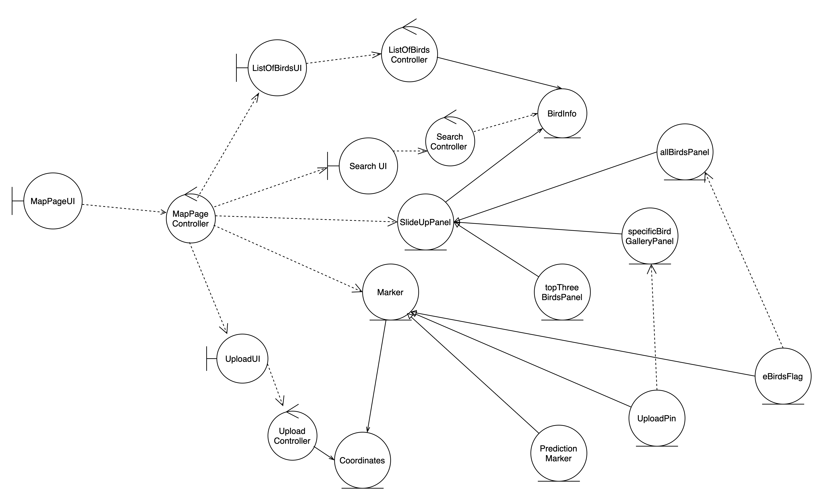
Key Boundary Class

Slide 25
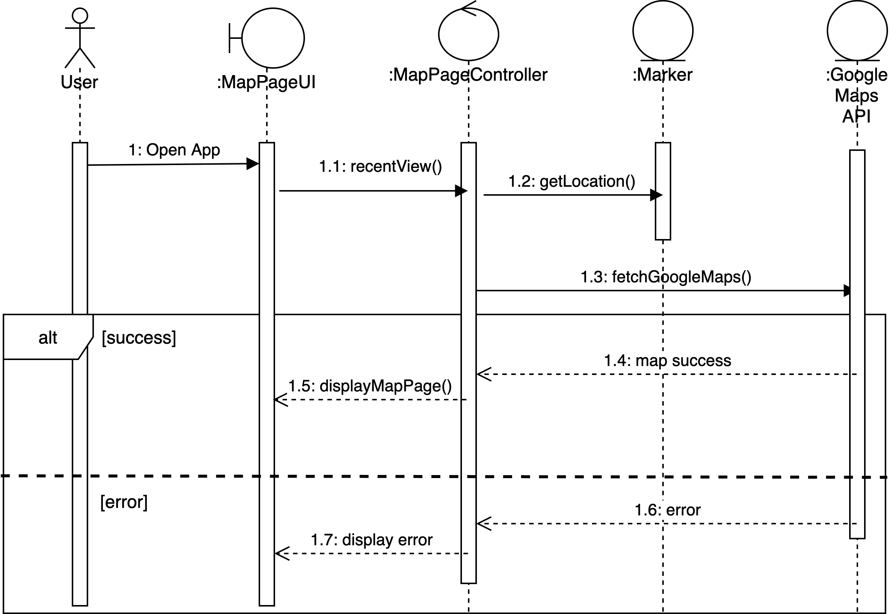
Sequence Diagrams for Use Case 1.1 (View Recent Sightings)

Slide 26
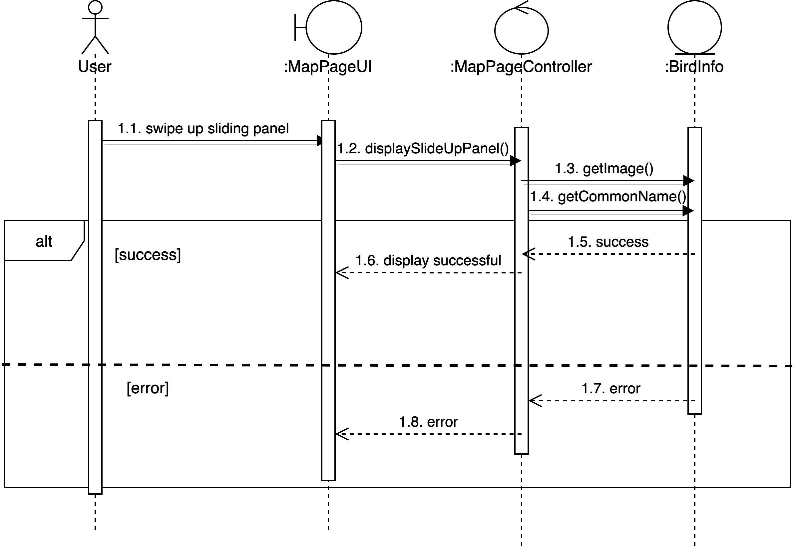
Sequence Diagrams for Use Cases: 3.1(View Top Three Birds)

Slide 27
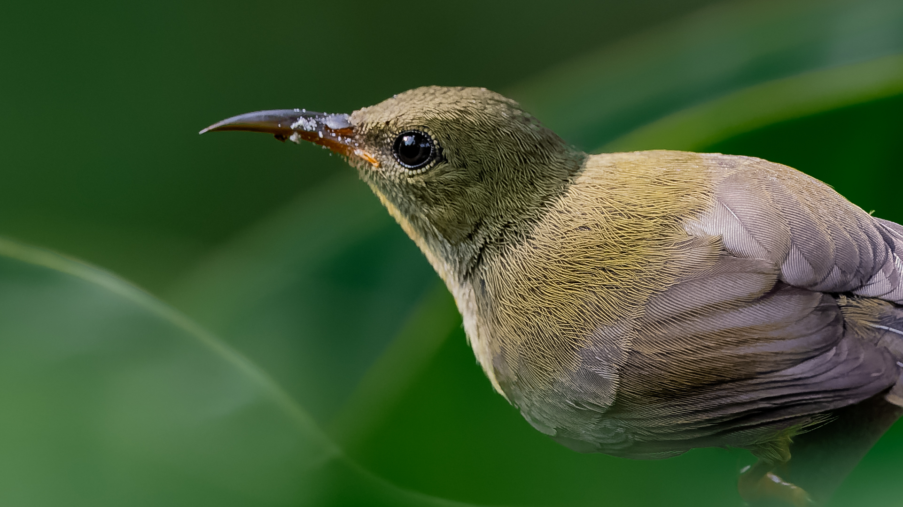
BirdGO

